Slide 1


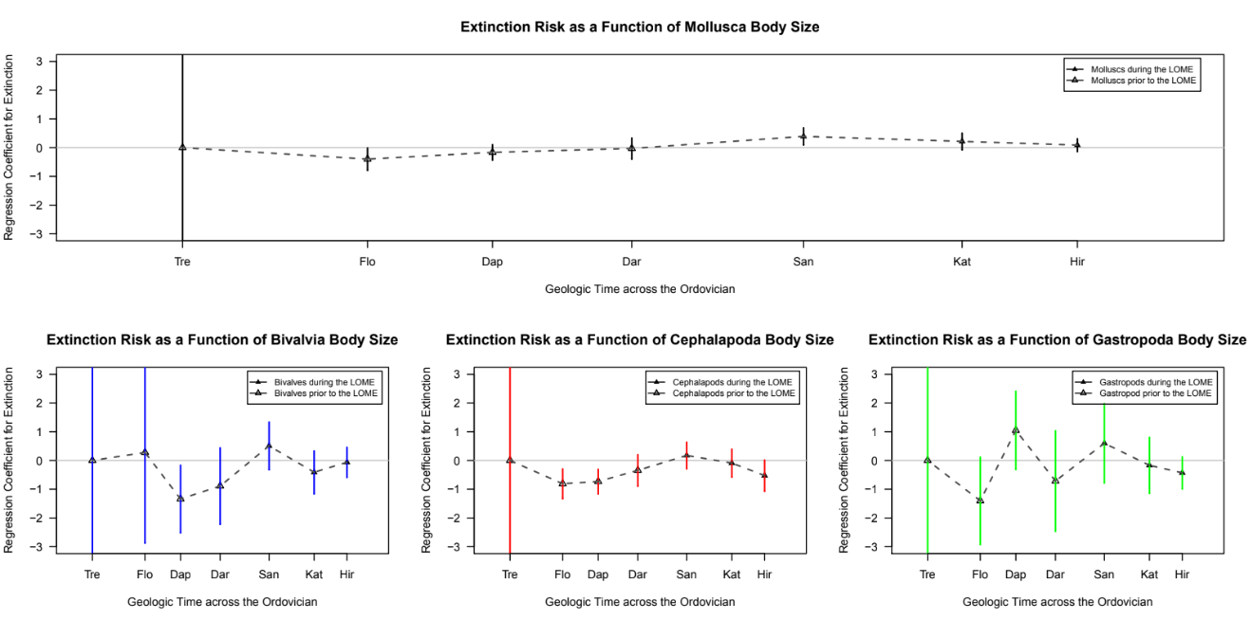
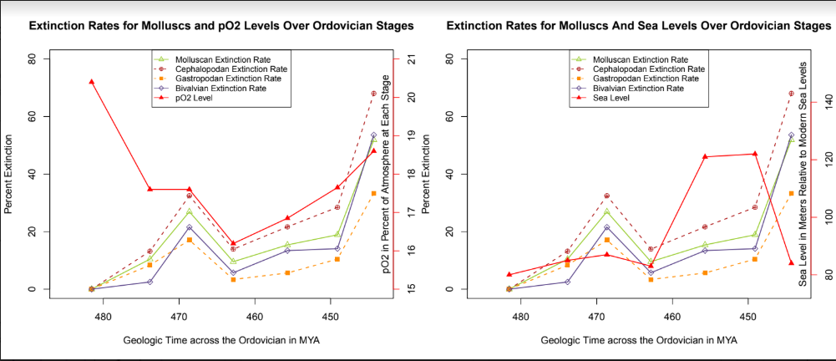
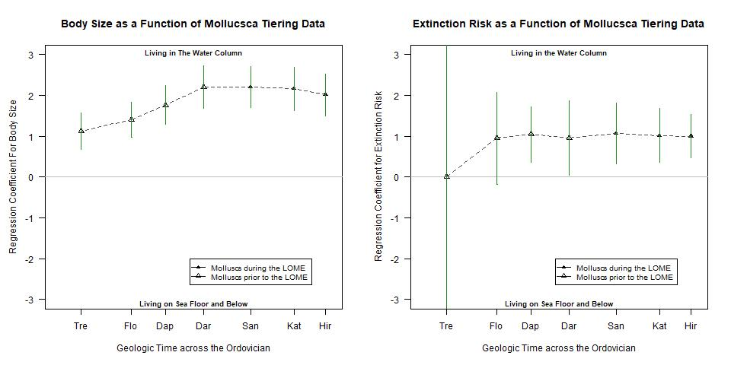
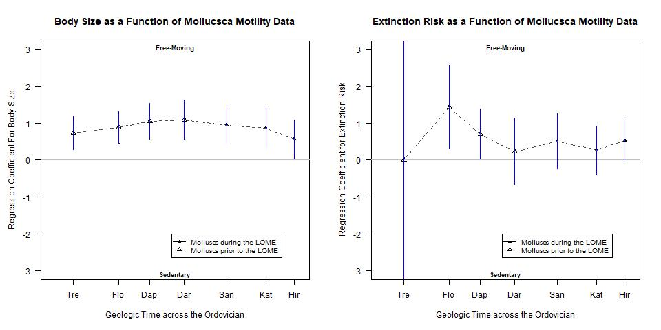
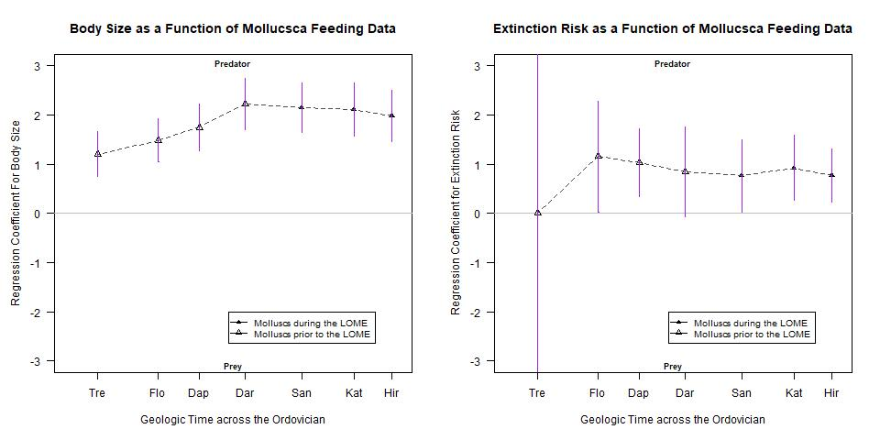
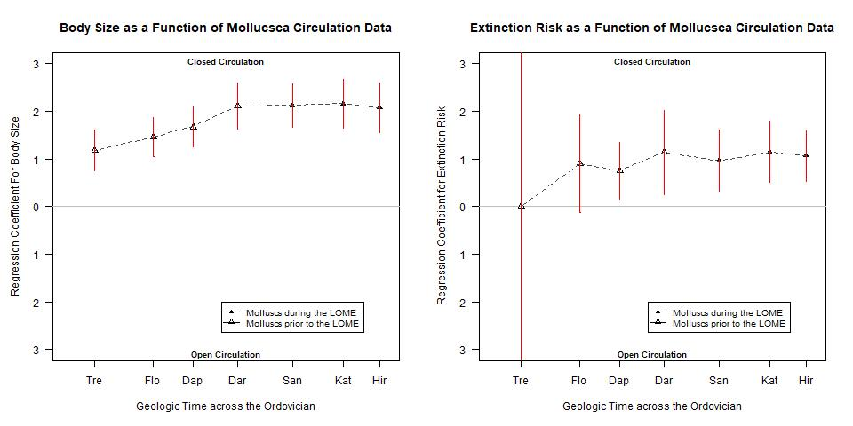
Driving Factors of Extinction for Molluscs During
the Late Ordovician Mass Extinction
Adarsh Ambati, Ilinca Flacau, Addy Ngo, Pedro Monarrez, Noel Heim, Jonathan Payne
Abstract
Figures
Results
While trends between extinction and body size have been explored extensively, few have studied them within the Late Ordovician Mass Extinction (LOME). None have attempted to observe it with Mollusca as a focal point. Additionally, our research investigated ecological factors and their relationship with body size and extinction risk.
Using R, we subsetted data from Heim et al. 2015 into three main classes, Cephalopoda, Bivalvia, and Gastropoda. First, we conducted logistic regression analyses to determine the odds of extinction based on calculated fossil biovolume. Next, we ran Pearson’s Correlation test to compare the calculated odds to the sea level and pO2 of each Ordovician stage. Secondary logistic regression analyses were performed on the entire molluscan dataset, comparing body size and extinction to circulation, feeding, motility, and tiering data, followed by correlation tests between these odds and sea level and pO2. While our first test for the main classes yielded no significant results, our second tests involving ecological traits found significant (p < 0.05) and strongly positive coefficients. For example, there were high odds of extinction for molluscs with closed circulation. The regression coefficient for extinction risk and genera with closed circulation was 1.06 in the LOME, indicating that such organisms were more likely to go extinct. Analysis revealed this likelihood had actually reduced from earlier stages. Additionally, there were strong positive correlations between coefficients for extinction and body size for the traits of predatory feeding, water column tiering, and a closed circulation. These are all features of cephalopods, indicating that the high coefficients are due to cephalopodic extinction. Furthermore, the correlations between the calculated coefficients of body size, extinction risks, and ecological factors to pO2 and sea levels yielded mixed yet significant results.
While there exists no clear relationship between body size and extinction for molluscs in the LOME, alternative physiological and ecological information act as better predictions for body size and extinction risk during this time. These factors clearly play a role in the underpinning mechanisms of mass extinctions, indicating that extinction trends are more complex than simple correlations.
Our first tests with the individual classes of Cephalopoda, Gastropoda, and Bivalvia revealed no significant results with regards to the relationship between body size and extinction rates. As evident in Fig. One, the logistic regression coefficients were not significant although there appeared to be a shift in the relationship between body size and extinction rates during the Late Ordovician Mass Extinction. Bivalves, Cephalopods, and Gastropods had no significant result but appear that smaller organisms tended to have a high extinction risk between the Hirnantian and the Katian, the two main stages of the LOME. Interestingly, when the scope is increased to the entire phylum of Mollusca, larger organisms tended to have a high extinction risk during the LOME, although this tendency is ostensibly decreasing. In the end, these initial tests found no major conclusions except for a decreasing tendency of larger molluscs to go extinct during the LOME. Our second set of tests that incorporate information about circulation, feeding, tiering, motility. After dividing the molluscan data into closed versus open circulation, predatory versus prey, living in the water column vs the seafloor, and motile vs sedentary traits, we ran logistic regression analyses between this data and body size as well as extinction risk. There were strong, positive coefficients that indicated that close circulatory, predatory, motile, and water-column molluscs tended to have a large body size yet a higher risk of extinction. Figure 2.A. shows the low correlation between sea level and pO2 and molluscan percentage extinction and Figure 2.B shows the low correlation between sea level and pO2 and molluscan body size. Notably in Figure 2.A, while oxygen levels do not have a clear correlation with the percentage extinction, between the stages of Darwillian and Sandbian or the third and fourth stages of the Ordovician. When we look at extinction odds, not percentages, the few significant correlations were between pO2 and Circulation vs Extinction Regression Coefficients, Feeding vs. Body Size, and Tiering vs Extinction. Some pO2 and sea level correlations had a significance between 90% and 95% and had important correlation coefficients. Such correlations were between pO2 and Circulation vs. Body Size Regression Coefficients, Feeding vs Extinction, Motility vs. Body Size, and Tiering vs. Body Size as well as one correlation between sea level and Body Size vs. Extinction Regression Coefficients.
Methodology
Discussion
While trends between extinction and body size have been explored extensively, hence the coining of the Lilliput Effect, or the noticed tendency for smaller organisms to remain after a mass extinction, few have studied this hypothesized trend within the Late Ordovician Mass Extinction. None have attempted to observe it with Mollusca as a focal point. Additionally, our research investigated ecological factors and their relationship with body size and extinction risk. First, we divided data from Heim et. al. 2015 into three main classes, Cephalopoda, Bivalvia, and Gastropoda. We ran logistic regression analyses to determine the odds of a higher extinction rate based on calculated fossil biovolume. Next, we ran Pearson’s correlation test to compare the odds to the sea level and pO2 of each Ordovician stage. Logistic regression analyses were performed on the entire molluscan dataset, comparing body size and extinction rates to circulation, feeding, motility, and tiering data, followed by correlation tests between these odds and sea level and pO2.
icating that extinction trends are more complex than simple correlations.
1
Primary Analyses
3
Secondary Analyses
Bivalvia, Cephalopoda,
Gastropoda classes
Mollusca phylum
Logistic Regression Analysis*
Logistic Regression Analysis*
~
Body Size
or
Extinction Risk
~
Circulation
or
Feeding
or
Tiering
or
Motility
Body Size Extinction Risk
 | pO2 Correlation Coefficient | P-Value | Signficant? | Sea Level Correlation Coefficient | P-Value | Signficant?
Body Size vs. Extinction Regression Coefficient | -0.08650737 | 0.8537 | N | 0.7295391 | 0.06276 | N (Barely)
Circulation vs. Body Size Regression Coefficient | -0.6853059 | 0.08928 | N (Barely) | 0.5807644 | 0.1715 | N
Circulation vs Extinction Regression Coefficient | -0.8139666 | 0.02587 | Y | 0.4121079 | 0.3582 | N
Feeding vs. Body Size Regression Coefficient | -0.7775291 | 0.03961 | Y | 0.5442933 | 0.2065 | N
Feeding vs Extinction Regression Coefficient | -0.7472472 | 0.05354 | N (Barely) | 0.209763 | 0.6517 | N
Motility vs. Body Size Regression Coefficient | -0.7339194 | 0.06041 | N (Barely) | 0.1491589 | 0.7496 | N
Motlity vs Extinction Regression Coefficient | -0.2803931 | 0.5425 | N | -0.1337023 | 0.775 | N
Tiering vs. Body Size Regression Coefficient | -0.7455968 | 0.05437 | N (Barely) | 0.5786803 | 0.1735 | N
Tiering vs Extinction Regression Coefficient | -0.8250547 | 0.02232 | Y | 0.4095584 | 0.3615 | N
2
4
 | pO2 Correlation Coefficient | P-Value | Signficant? | Sea Level Correlation Coefficient | P-Value | Signficant?
Body Size vs. Extinction Regression Coefficient | -0.08650737 | 0.8537 | N | 0.7295391 | 0.06276 | N (Barely)
Circulation vs. Body Size Regression Coefficient | -0.6853059 | 0.08928 | N (Barely) | 0.5807644 | 0.1715 | N
Circulation vs Extinction Regression Coefficient | -0.8139666 | 0.02587 | Y | 0.4121079 | 0.3582 | N
Feeding vs. Body Size Regression Coefficient | -0.7775291 | 0.03961 | Y | 0.5442933 | 0.2065 | N
Feeding vs Extinction Regression Coefficient | -0.7472472 | 0.05354 | N (Barely) | 0.209763 | 0.6517 | N
Motility vs. Body Size Regression Coefficient | -0.7339194 | 0.06041 | N (Barely) | 0.1491589 | 0.7496 | N
Motlity vs Extinction Regression Coefficient | -0.2803931 | 0.5425 | N | -0.1337023 | 0.775 | N
Tiering vs. Body Size Regression Coefficient | -0.7455968 | 0.05437 | N (Barely) | 0.5786803 | 0.1735 | N
Tiering vs Extinction Regression Coefficient | -0.8250547 | 0.02232 | Y | 0.4095584 | 0.3615 | N
Pearson’s Correlation Test
Step 1
Regression Coefficients
~
Partial Pressure of Oxygen
Pearson’s Correlation Test
Step 3
Regression Coefficients
~
Partial Pressure of Oxygen
Step 1
Regression Coefficients
~
Sea Level
Step 3
Regression Coefficients
~
Sea Level
Acknowledgments
 | pO2 Correlation Coefficient | P-Value | Signficant? | Sea Level Correlation Coefficient | P-Value | Signficant?
Body Size vs. Extinction Regression Coefficient | -0.08650737 | 0.8537 | N | 0.7295391 | 0.06276 | N (Barely)
Circulation vs. Body Size Regression Coefficient | -0.6853059 | 0.08928 | N (Barely) | 0.5807644 | 0.1715 | N
Circulation vs Extinction Regression Coefficient | -0.8139666 | 0.02587 | Y | 0.4121079 | 0.3582 | N
Feeding vs. Body Size Regression Coefficient | -0.7775291 | 0.03961 | Y | 0.5442933 | 0.2065 | N
Feeding vs Extinction Regression Coefficient | -0.7472472 | 0.05354 | N (Barely) | 0.209763 | 0.6517 | N
Motility vs. Body Size Regression Coefficient | -0.7339194 | 0.06041 | N (Barely) | 0.1491589 | 0.7496 | N
Motlity vs Extinction Regression Coefficient | -0.2803931 | 0.5425 | N | -0.1337023 | 0.775 | N
Tiering vs. Body Size Regression Coefficient | -0.7455968 | 0.05437 | N (Barely) | 0.5786803 | 0.1735 | N
Tiering vs Extinction Regression Coefficient | -0.8250547 | 0.02232 | Y | 0.4095584 | 0.3615 | N
While trends between extinction and body size have been explored extensively, hence the coining of the Lilliput Effect, or the noticed tendency for smaller organisms to remain after a mass extinction, few have studied this hypothesized trend within the Late Ordovician Mass Extinction. None have attempted to observe it with Mollusca as a focal point. Additionally,
All analyses and plots were made using the programming language R
*Logistic Regression Analyses were performed for each stage of the Ordovician
Body Size : Base 10 Logarithm of the Calculated Biovolume
Circulation: Open vs Closed
Feeding : Predatory vs Non-Predatory (Suspension, Surface Deposit, Mining, Grazing, and Other)
Tiering: Pelagic vs Sea Floor and Below(Erect, Surficial, Semi-infaunal, Shallow infaunal, and Deep infaunal)
Motility: Freely vs Sedentary (Facultative and Non-motile)
Citations
While trends between extinction and body size have been explored extensively, hence the coining of the Lilliput Effect, or the noticed tendency for smaller organisms to remain after a mass extinction, few have studied this hypothesized trend within the Late Ordovician Mass Extinction. None have attempted to observe it with Mollusca as a focal point. Additionally,

